Slide 1
Olde Time Movie Rentals: JAB Solution
Akhil Devarapalli, Joseph Telaak, Ben Charest
Notes:
Ben

Slide 2
01
THE PROBLEM
Overview of Old Time Movie Rentals
Notes:
Joseph

Slide 3
OLDE TIME MOVIE RENTALS
Olde Time Movie Rentals is a movie rental company located in Columbia, SC. The company opened two years ago, and is growing exponentially. Managing data has become overly time consuming, so they have seeked out JAB, a local database company, to engineer a solution.
Notes:
Joseph

Slide 4
SOLUTION SPECIFICATIONS:
Each store has a single unique distributor, but said distributor can supply multiple stores
Each store must have a name, address, and phone number
Employee information must be stored within the data (employee name, supervisor, store location, home address, phone number, SSN, hire date)
Customer information must be stored within the data (name, address, phone number)
Movie rental data must be stored (employee who made sale, customer, movie title, movie copy, payment, date, status, rental rate, due date)
Payment specifics must be stored (payment type, type based specifics - CC number for credit cars, etc)
Inventory data must also be stored (media condition, movie title, director, description, star-actor, movie rating, genre)
Notes:
Ben

Slide 5
ER Diagram
TABLES
01
02
SQL
03
WEB APP / REGISTER
04
The JAB Plan of Action
First, we had to organize all of the required data into tables. During this process, we identified functional dependencies and normalized the database
After normalizing the database, we created an ERD to visualize the relationships. In the ERD, we specified the cardinalities of each relationship and specified if the entity was a strong or weak entity.
We implemented our solution using mySQL to engineer our database. In our SQL code, we specified constraints to ensure our database integrity.
To verify that our database worked accurately, we engineered 10 queries that tested specifics of the database. We displayed the results as reports using a webapp. We also created a register application that could be used to create transactions.
Notes:
Akhil

Slide 6
02
TABLES
Our data organization and design process
Notes:
Ben

Slide 7
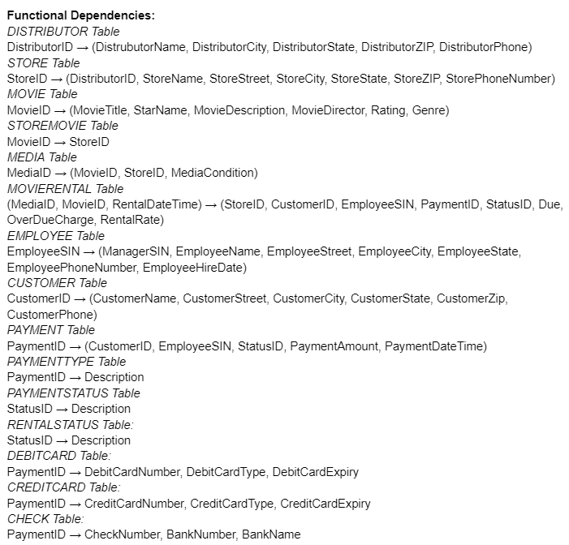
Functional Dependencies
FD - Where one entity can determine another entity
Preliminary step to creating data model (ERD)
Used in order to normalize the database into BCNF
Helps to identify and prevent any redundancies
Notes:
Ben

Slide 8
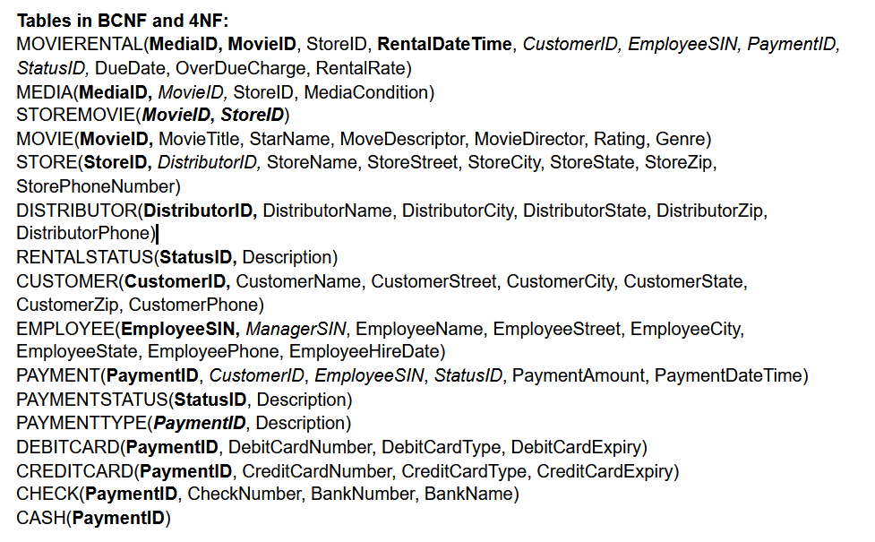
Tables
Organized data into tables
Created primary keys and foreign keys to identify relations
Tables were already given, but we had to identify relations, cardinalities, and keys
Notes:
Ben

Slide 9
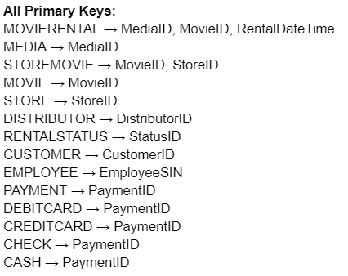
Primary Keys
The primary key is a specific key that can be used to determine all other attributes in a table
Mostly used surrogate keys
Generated ID numbers
Entirely unique
Easy to query
Had to use a concatenated key for a few entities
Notes:
Akhil

Slide 10
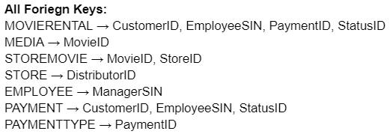
Foriegn Keys
Foriegn keys are primary keys that occur in other tables
They are used to reference the table they are the primary key of
Notes:
Akhil

Slide 11
03
ER DIAGRAM
Our visual representation of the proposed database solution
Notes:
Ben

Slide 12
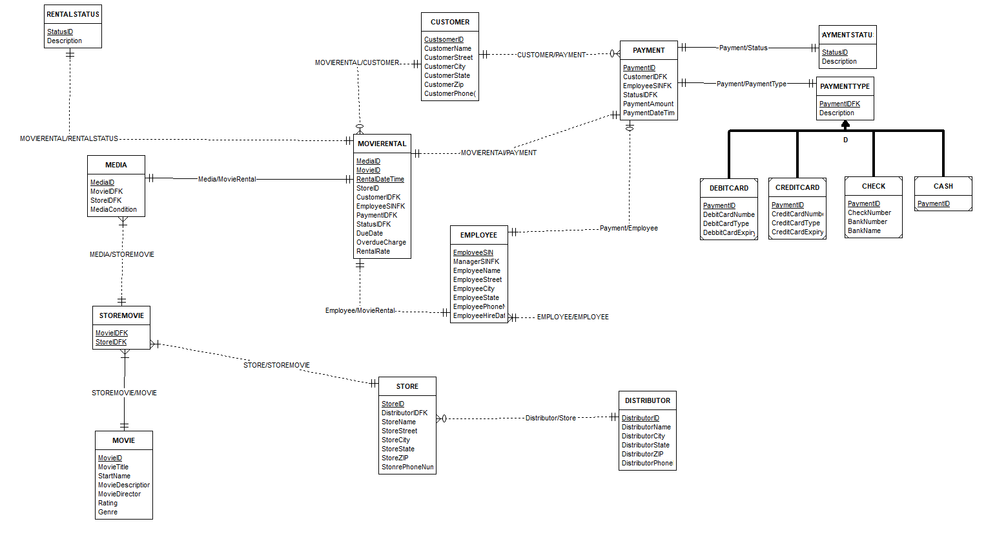
Complete ERD
Notes:
Joseph

Slide 13


The ERD Can Be Divided Into 3 Sections
Inventory
Payment
Movie rental
Notes:
Joseph

Slide 14
04
INVENTORY
Inventory management with our database
Notes:
Akhil

Slide 15
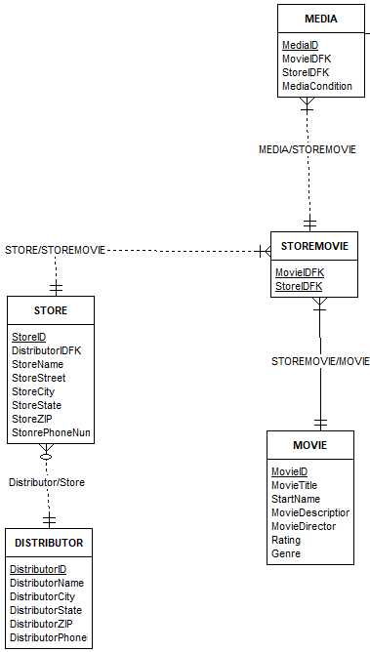
Assumptions:
A STORE must have one and only ONE distributor
A DISTRIBUTOR can supply multiple stores
A STORE must have STOREMOVIE
Ex. a store cannot exist if it does not carry any movies
A MOVIE must have A STOREMOVIE
A movie won’t be represented in our database unless it is carried in a store
MEDIA must have STOREMOVIE
Media copy can’t exist without a store movie
Notes:
Akhil

Slide 16
05
PAYMENT SYSTEM
Payment handling within the database
Notes:
Ben

Slide 17
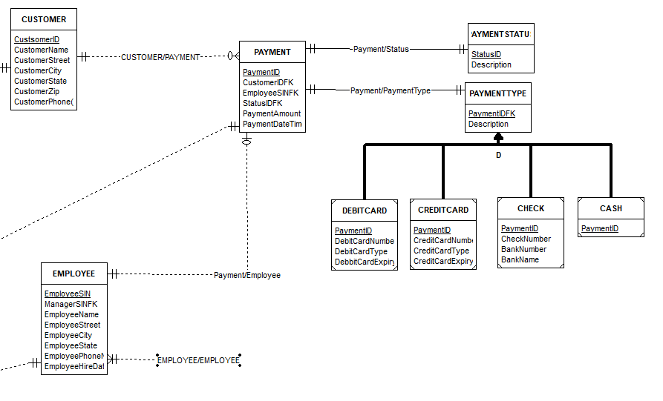
Assumptions:
PAYMENT must have both a CUSTOMER and EMPLOYEE
Ex. There cannot be a payment without there first being a customer
PAYMENT must have PAYMENTSTATUS and PAYMENTTYPE
The customer must complete the payment with only one payment type
Ex. the customer cannot pay half with cash and half with card
Notes:
Ben

Slide 18
06
MOVIE RENTAL
The overall movie rental system within the database
Notes:
Akhil

Slide 19
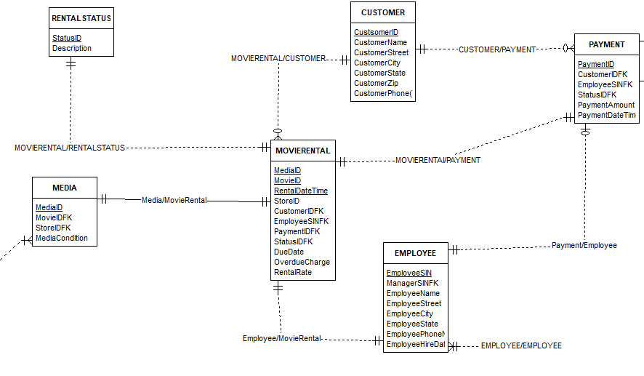
Assumptions:
MOVIERENTAL must have PAYMENT, CUSTOMER, EMPLOYEE, RENTALSTATUS, and MEDIA
A customer can make more than one movie rental
Notes:
Akhil

Slide 20
07
SQL
Our implementation of our solution using mySQL
Notes:
Akhil

Slide 21
Implementation with SQL
Created the database and its entities using SQL
This includes
Creating the tables
Primary keys and Foreign Keys
Used SQL to engineer queries that show that the database is functional
Notes:
Akhil

Slide 22

Constraints
In order to maintain referential integrity constraints, the SQL specifies the constraints of the table
For most attributes, we did not allow NULL values since NULL values tend to create problems in databases
Example constraint for PAYMENTTYPE:
Notes:
Akhil

Slide 23
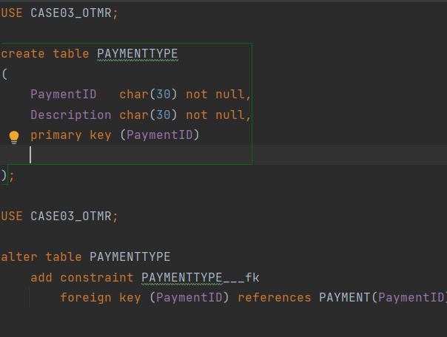
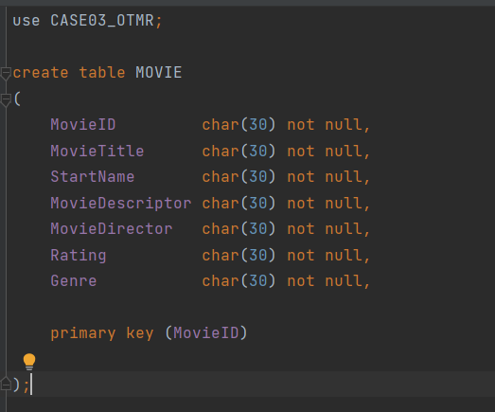
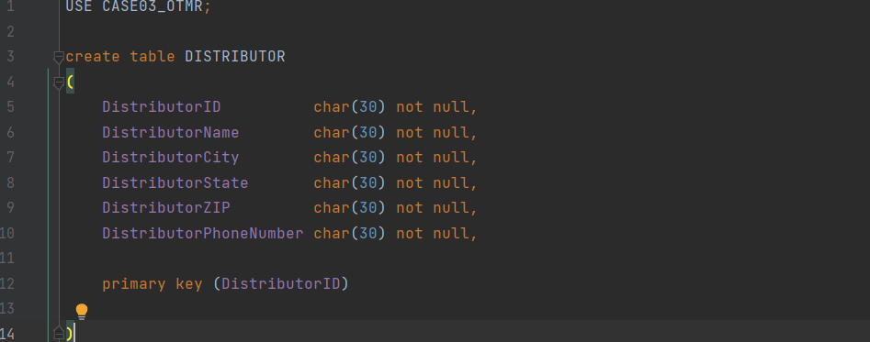
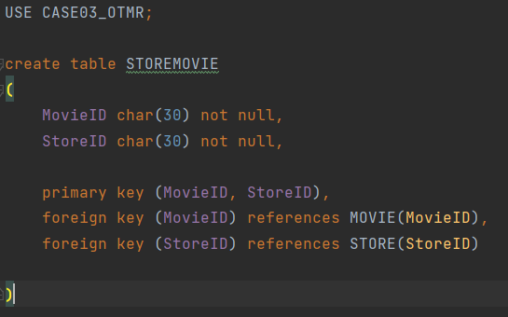
Notes:
Akhil

Slide 24
WEB APP AND REPORTS
08
The web application used to display our SQL query reports
Notes:
Joseph

Slide 25
09
REGISTER
Application usable by employees to create and manage transactions
Notes:
Akhil

Slide 26
10
CHALLENGES
Problems we encountered through our process
Notes:
Akhil

Slide 27
Challenges Encountered
Understanding the business rules
Learning a new library for python to build our register
Importing data into our database in a efficient manner
Maintaining referential integrity constraint
Learning Flask and React frameworks
Notes:
Akhil

Slide 28
11
REFLECTION
Overall thoughts on the case study as a whole
Notes:
Ben

Slide 29
Reflection
Primary design steps help make the whole design process much simpler and more efficient.
ERD
The use of GitHub helped all of us have the same version of the project which streamlined workflow
Use of Excel sheet helped keep track of everyone's responsibilities and progression of project
Communication essential to success as a team
The case study was very interesting due to its real world applications
Case study also helped solidify and implement the theory learned in class
The case study was completed in around 3 weeks
Notes:
Ben

Slide 30
GitHub
https://github.com/The1TrueJoe/Database-Case-Studies
https://github.com/The1TrueJoe/Database-Case-Studies/releases/tag/release1
Notes:
Joseph

Slide 31
References
Griffith University. (n.d.). Griffith University Normalization Tool. Griffith University Normalization Tools.
http://www.ict.griffith.edu.au/normalization_tools/normalization/ind.php
Kroenke, D., Auer, D., Yoder, R., & Vandenberg, S. (2018). Database Processing: Fundamentals, Design, and
Implementation (15th ed.). Pearson.
Oracle. (n.d.). MySql::MySql Documentation. MySql. https://dev.mysql.com/doc/
Notes:
Joseph

